Slide 1
Getting Started with Amazon Web Services
By: Zachary McKinnon

Slide 2
About Me
Software Engineer (10 years)
Curse
Contact
Github - https://github.com/zmckinnon
Tech256 - https://tech256.com

Slide 3
Agenda
History Lesson
The Cloud
AWS Overview
Demo

Slide 4
History
PEOPLE
INTERNET
SERVERS
ELECTRICITY
LICENSING

Slide 5

“The Cloud”
Amazon Web Services
Microsoft Azure
Google Cloud Platform
Others
IBM
Rackspace
Etc.

Slide 6
About AWS
Elastic Compute Cloud - EC2
Simple Storage Service - S3
Relational Database Service - RDS
Elastic Beanstalk - EB
Way More!!!

Slide 7
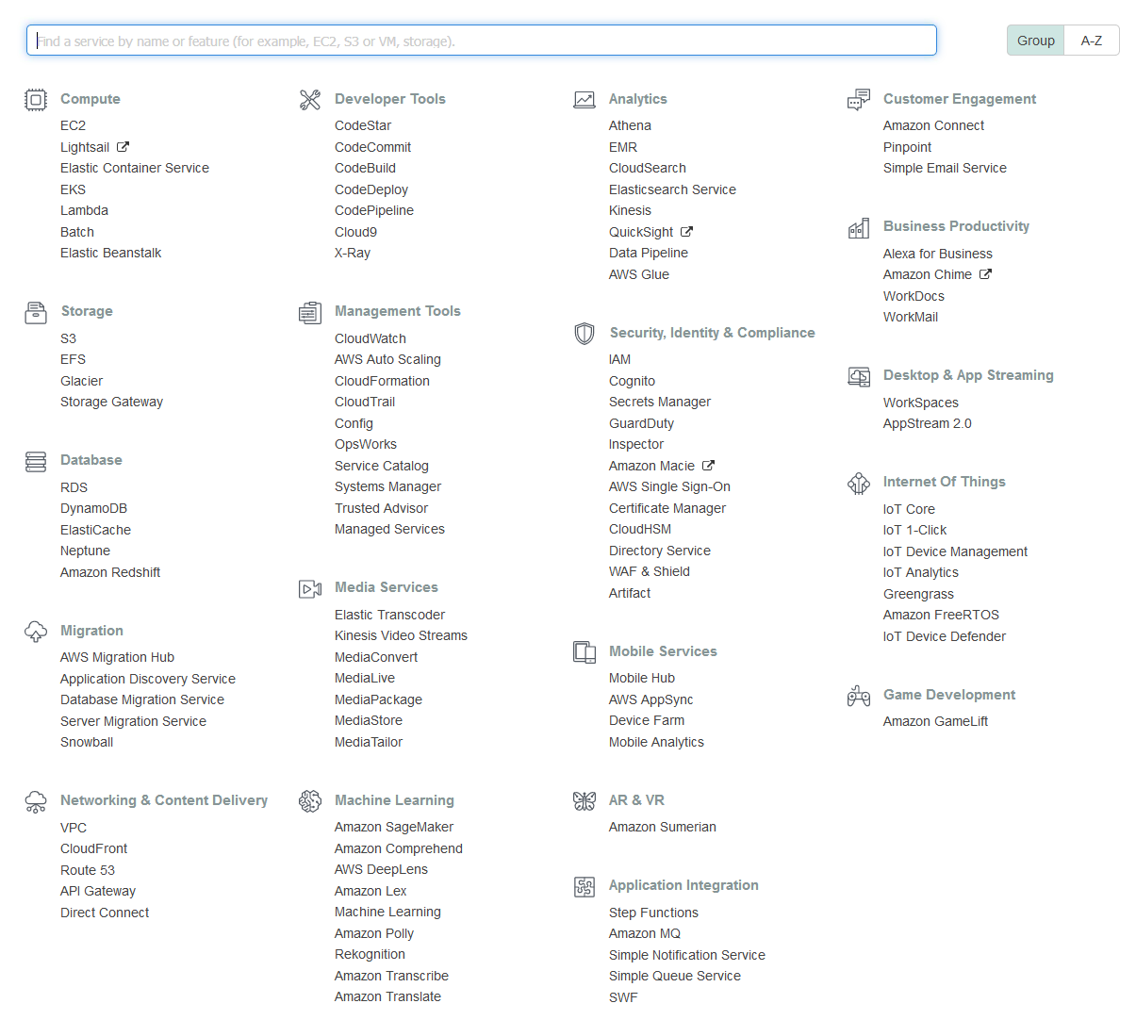

Slide 8
Demo

Slide 9
References
https://aws.amazon.com/

Slide 10
Questions?

